Slide 1
Data Bootcamp Final project:
Stock Return Direction Prediction
Menghan Liu
Yicheng Song
Jenny Zhu

Slide 2
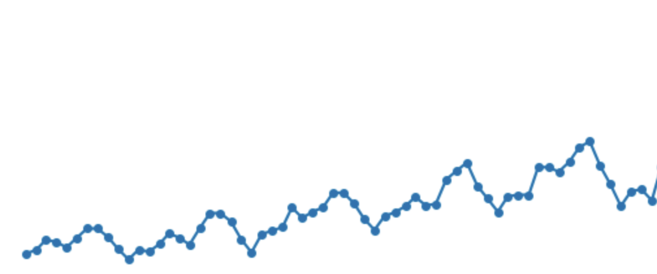
Research Focus and Topic Question
Can we predict next-month stock return direction?
Test whether market + fundamental data contain short-term predictive power
Focus on prediction accuracy & interpretation, not trading profits. (Binary Classifcation Problem --- Up or Down)

Slide 3
Data Sources
Primary Sources (via WRDS):
  CRSP Monthly Stock File: Market data (returns, price, volume) – Jan 2018 to Dec 2024.
  Compustat Fundamentals Quarterly: Accounting data (income, equity) for public firms.
  Linked via CCM Table: Maps CRSP identifiers to Compustat, enabling integration of market and accounting data.
Raw Data (50k obs)
↓
Deduplication (Keep most recent quarter)
↓
22,795 unique stock-months
↓
Feature Engineering & Remove Missing
↓
**Final Dataset: 21,224 observations**
↓
Train (80%) | Test (20%) – Ordered by stock/date

Slide 4
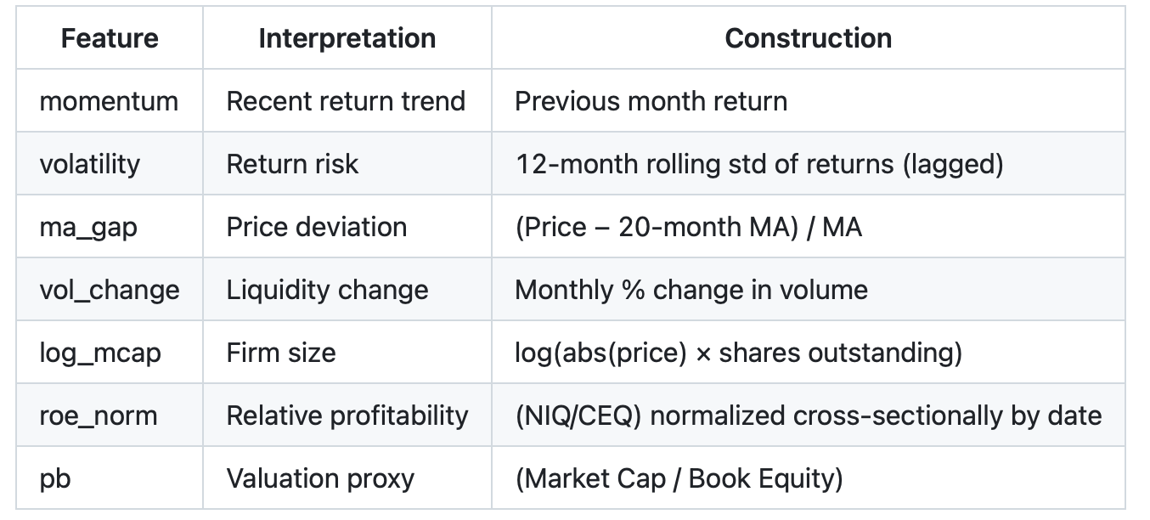
Feature Construction
Motivation:
  lack of comparability (vast differences in numerical scales across companies)
  absence of directional information (knowing only the value but not the trend)
  frequency mismatch (quarterly financial report data vs. monthly prediction needs)
Mesuares: Industry-standard processing techniques
Notes:
(log transformation for scale variables, cross-sectional standardization for comparability, rolling window calculations to capture dynamic changes)

Slide 5
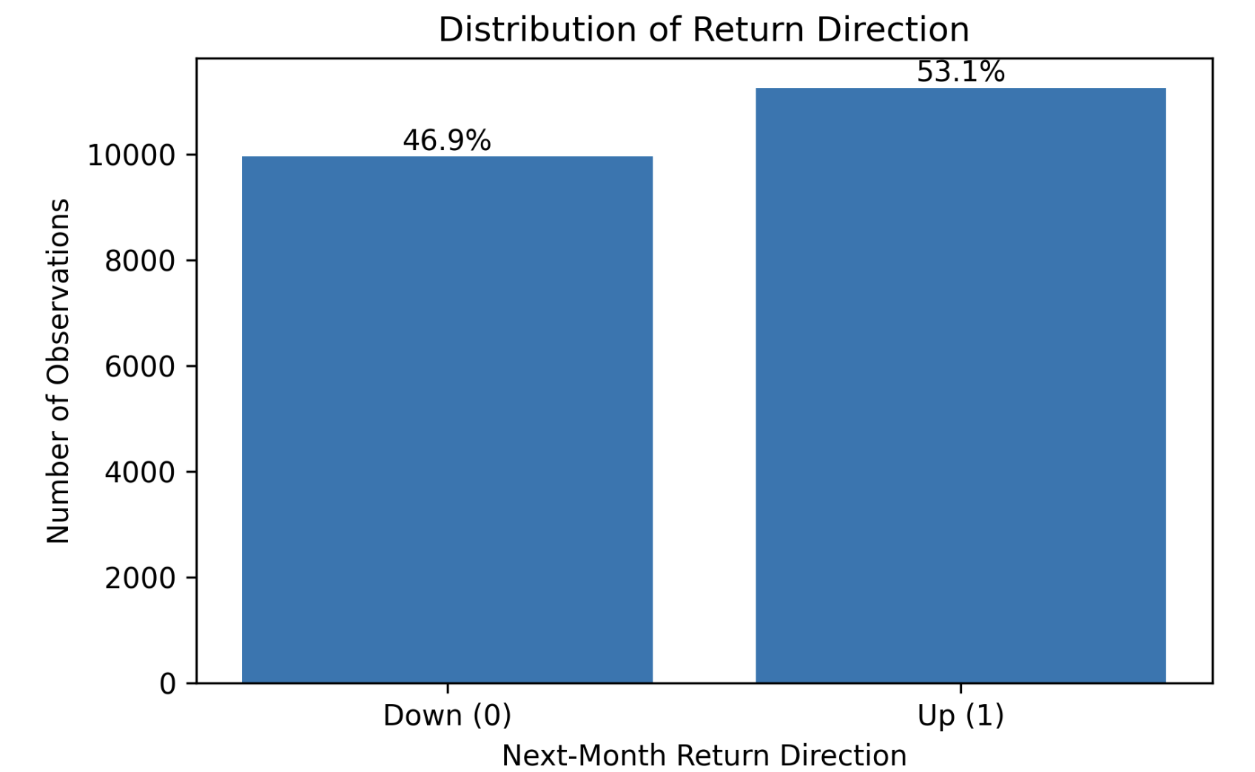
EDA
Key observations include:
The return direction label is mildly imbalanced, with positive returns occurring in approximately 53% of cases (Baseline)
Momentum and volatility display heavy tails and substantial dispersion
Fundamental proxies (ROE and PB) show weak univariate relationships with next-month returns

Slide 6
Models and Interpretation Tools
Logistic regression (Linear)
Random forest (Nonlinear)
Neural network (2+2 layers)
  (to test whether increased model flexibility improves predictive performance)
Logistic Regression Coefficients: Provide linear, directional insights
Random Forest Gini Importance: Shows which features are most frequently used and effective for tree splits, capturing non-linear interactions
Permutation Importance: Measures actual prediction impact by shuffling each feature and observing accuracy drop
Notes:
We compare models with increasing flexibility. Logistic regression serves as a simple and interpretable benchmark. Random forest allows for nonlinear relationships and interactions, while the neural network tests whether a high-capacity model can extract more signal from noisy financial data. All models are evaluated using out-of-sample accuracy.
We use a feedforward neural network with two hidden layers, each containing 100 neurons, and ReLU activations. The input layer has seven features, and the output layer predicts the probability of positive versus negative next-month returns

Slide 7
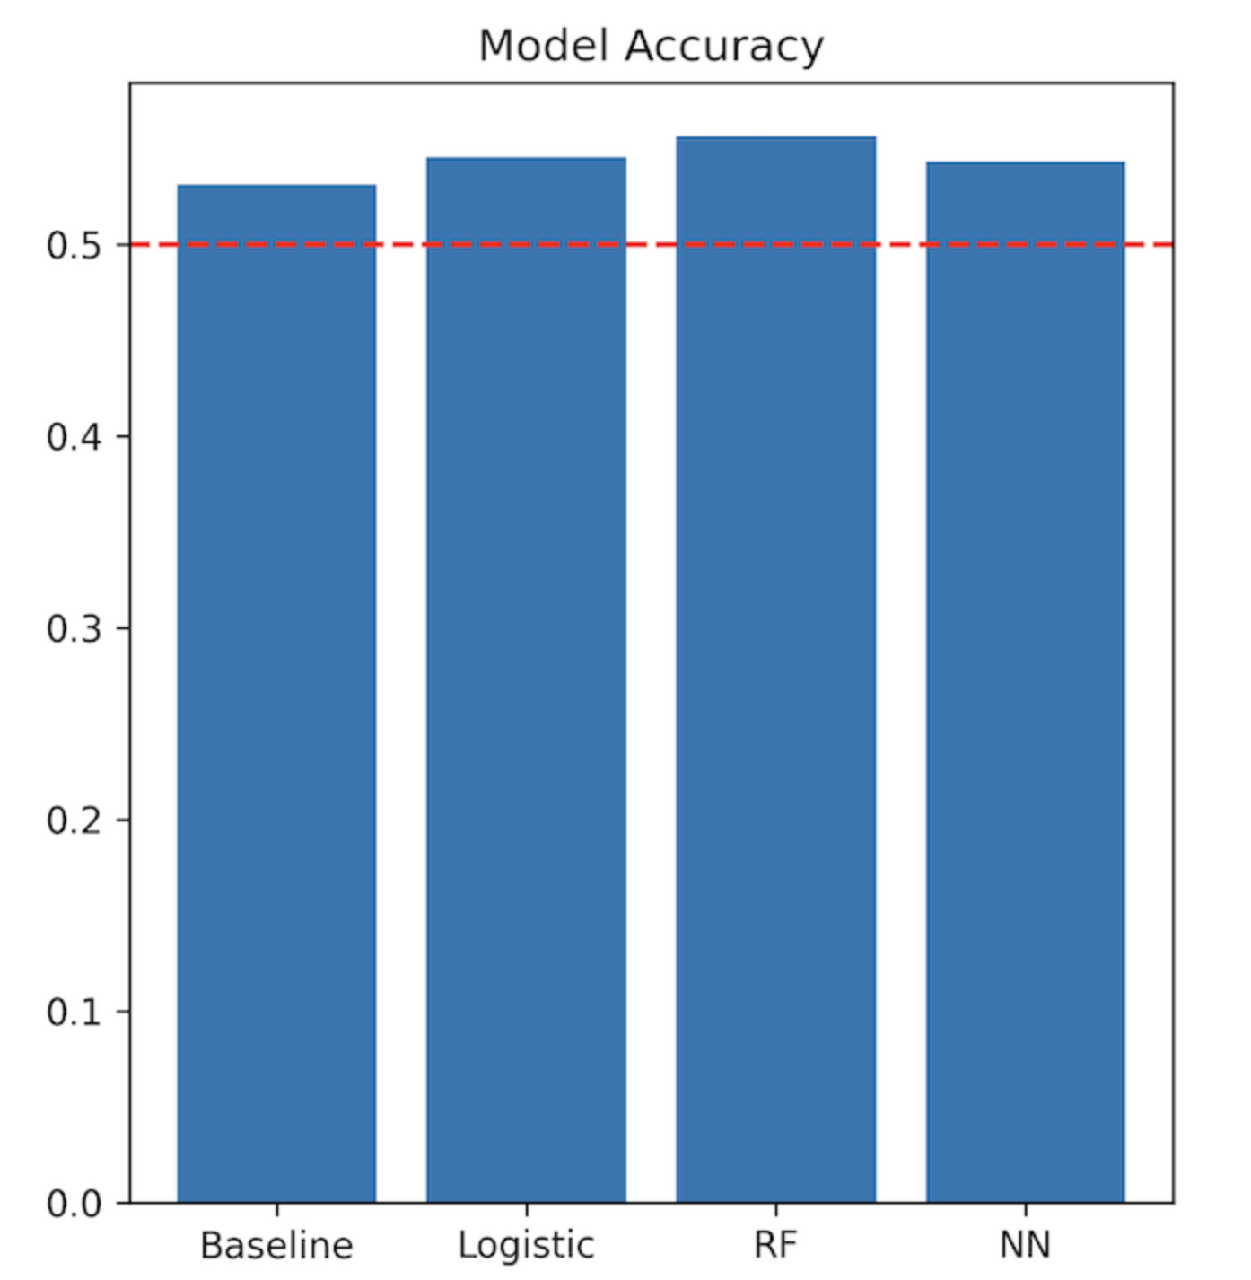
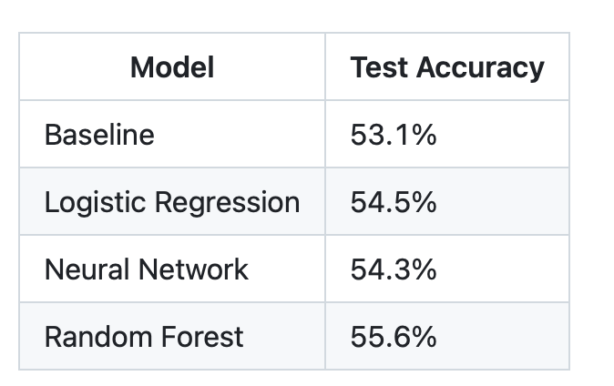
Results --- Model Performance
Notes:
The modest improvement over baseline highlights the difficulty of predicting next-month stock return direction. The limited dispersion in accuracy across models suggests that model choice has a relatively small impact compared to the intrinsic noise in short-horizon returns. The results are consistent with the efficient market hypothesis, which posits that publicly available information is quickly incorporated into prices, leaving limited predictable patterns.

Slide 8
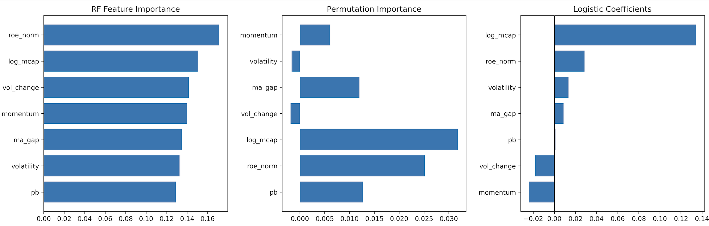
Results --- Feature siginificance

Slide 9
Discussion
Difficulty predicting downside months
Look-Ahead bias in methods and temporal lag of fundamentals in data
Future work could explore longer prediction horizons (3-6 months)

Slide 10
Conclusion
Tested predictability of next-month returns
Small gains over baseline (~55.6%) with Random Forest being the best
Firm size and profitability matter most

Slide 11
Thanks

